Slide 1
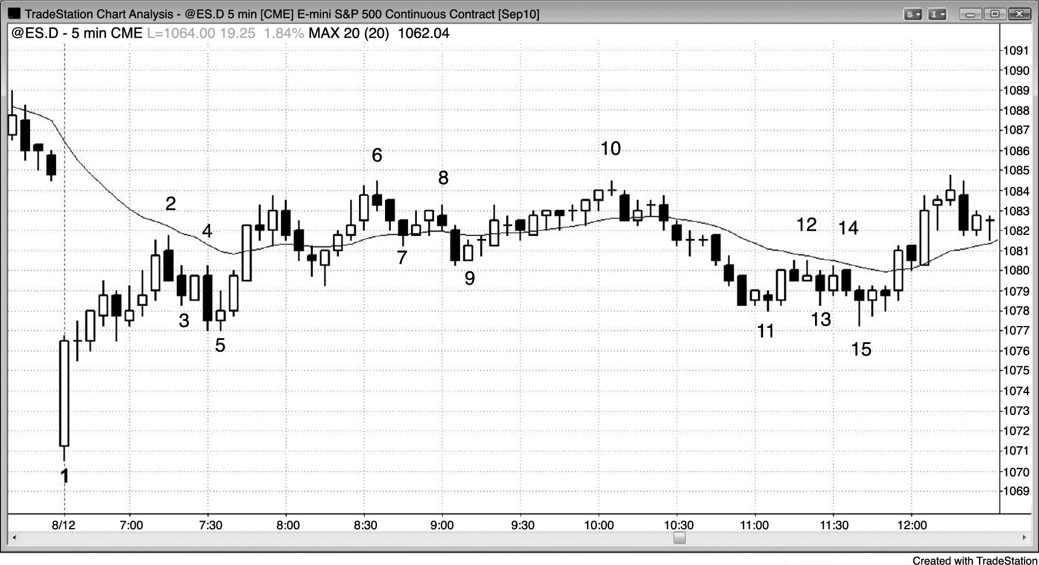
FIGURE PI.1 Two-Legged Pullbacks

